Slide 1

Car Recommender
Determining your car brand and model

Slide 2

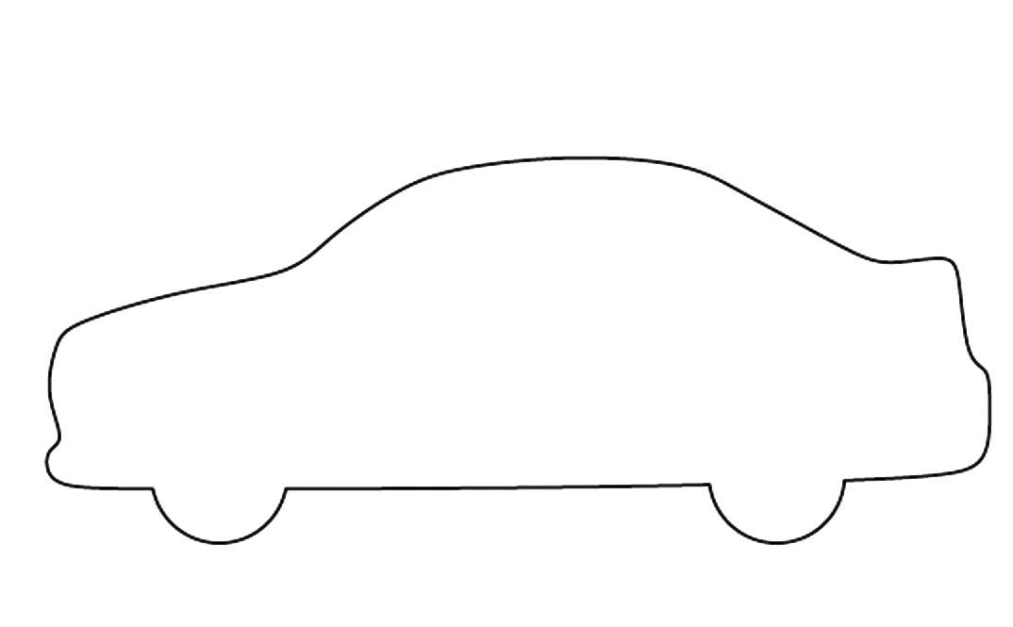





What brand is interesting for me?
How much will such a car cost?
What is the milage of the car?
Selecting your car
What are the prices of the options?
?
Your dream car
Type
Fuel
Engine
Transmission
Drive
And many other car features

Slide 3

Scraping
Data Manipulation and KNN missing imputation
Autotrader.co.uk
13000 cars
Methodology
Determine Car Specific options
User based collaborative filtering
Recommendations
Data
User Input
Information Output
Shiny Application
EDA
Linear Regression
Box Cox
Elestic Net
GBM
Statistical Models
Statistical Testing

Slide 4
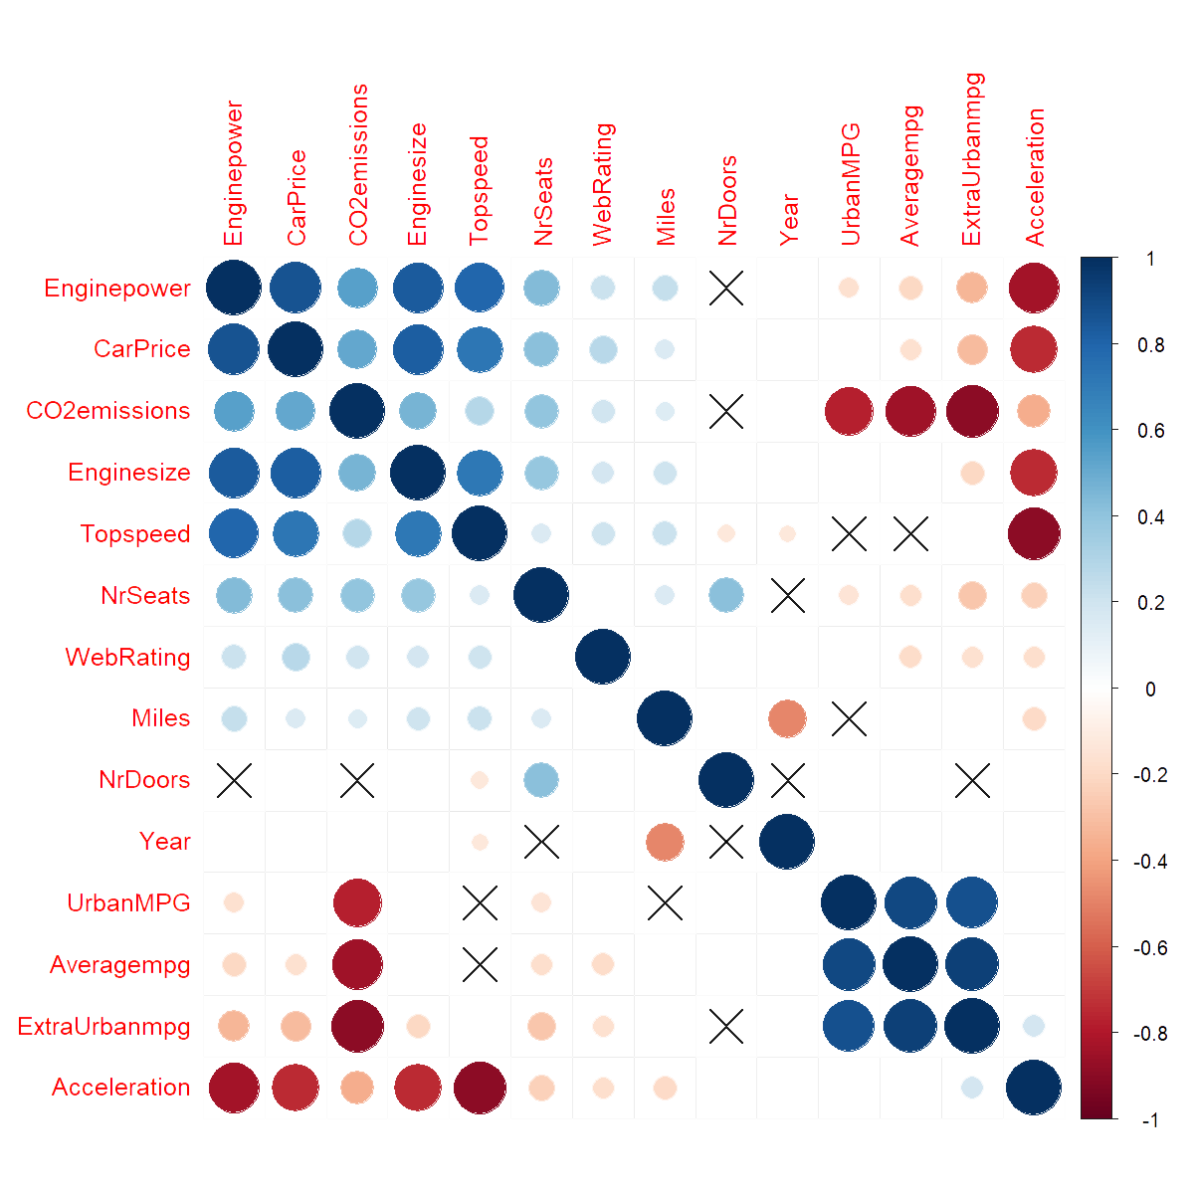
Exploratory Analysis

Slide 5
Attempting to predict the car price
Train R2 Test R2
Machine Learning Models
Linear Regression
Manual
0.90 0.899
Stepwise
0.914 0.914
Box Cox
0.900 0.899
Elastic Net
0.916 0.921
Gradient Boosting
0.979 0.957

Slide 6
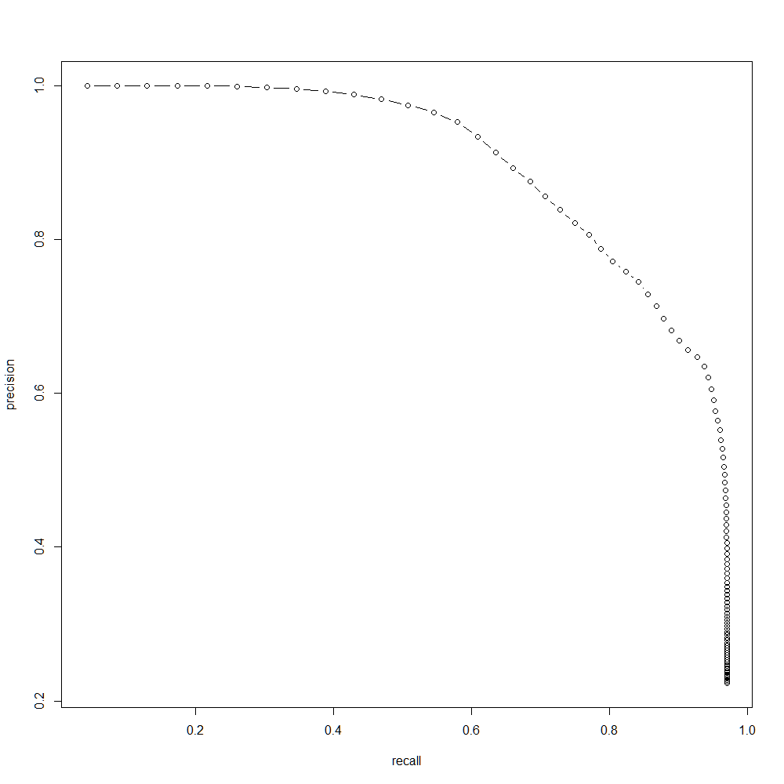
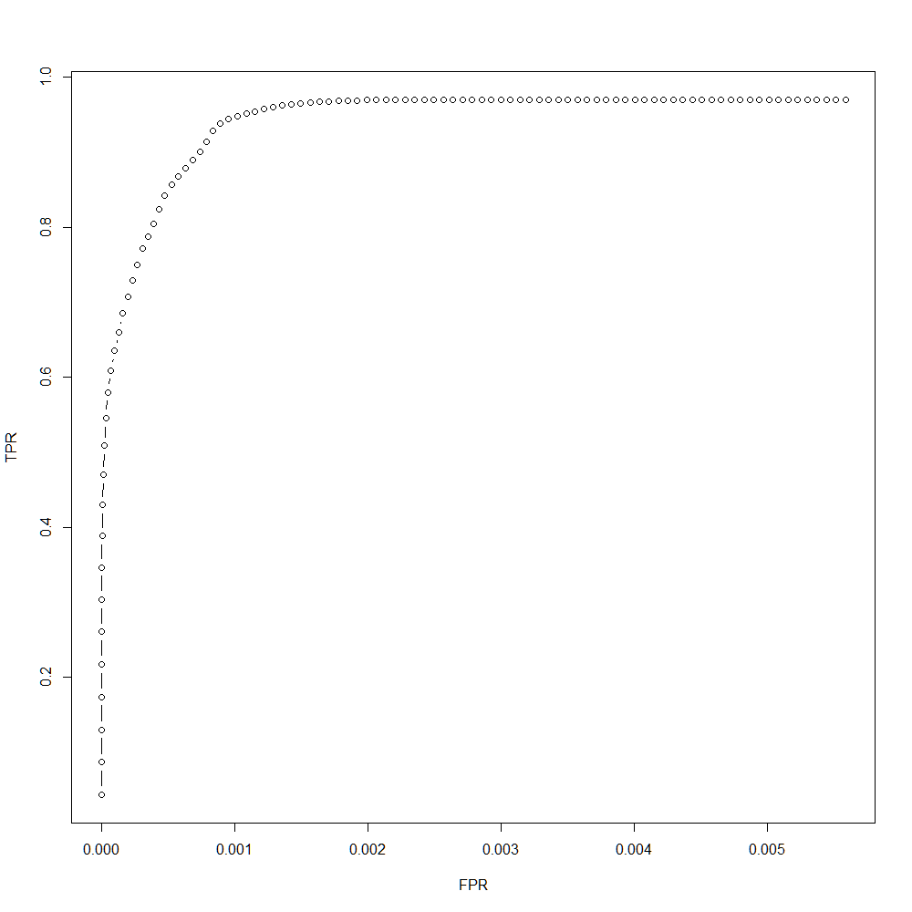
Collaborative Filtering
Collaborative filtering (CF) uses given rating data by many users for many items as the basis for creating a top-N recommendation list.
The assumption is that users with similar preferences will rate items similarly. Thus missing ratings for a user can be predicted by first finding a neighborhood of similar users and then aggregate the ratings of these users to form a prediction (K nearest neighbors).
Recommendations
High precision (how useful the search results are) for high recall (how complete the results are)
High number of true positive predictions for a low number of false positive predictions
Notes:
recall (also known as sensitivity) is the fraction of relevant instances that have been retrieved over the total amount of relevant instances.
precision (also called positive predictive value) is the fraction of relevant instances among the retrieved instances

Slide 7

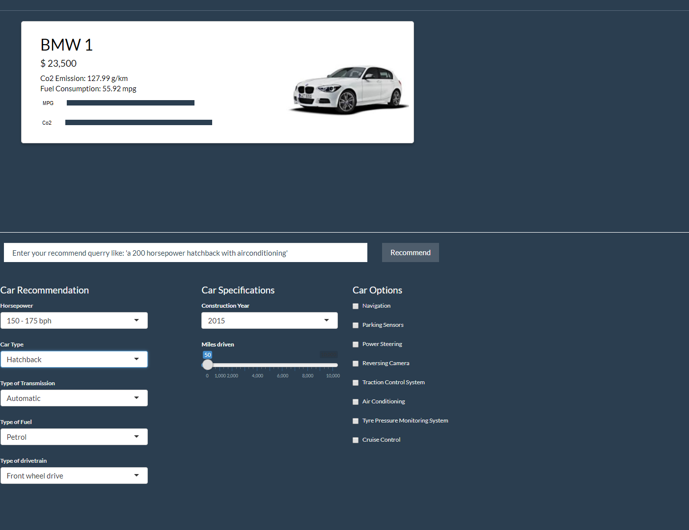


A
Text interpretation
Recommendation engine based on user based collaborative filtering
Linear Regression models for the prediction of the car price
Car Recommender

Slide 8
Car Recommender
Determining your car brand and model

